Slide 1

Generating Text with LSTM Networks

Slide 2

Introduction
Introduction
Content
Introduce LSTM networks as a type of recurrent neural network that can model sequences of data
Briefly explain the significance of text generation and its applications in areas such as creative writing, chatbots, and automated content creation

Slide 3

Process Overview
Text Generation Process
Content
Outline the step-by-step process for generating text
Feed the network with an initial sequence of words
Use the network to predict the next word
Append the predicted word to the sequence
Repeat the process to generate a longer string of text

Slide 4

Sampling with Temperature
Sampling with Temperature
Content
Explain the concept of sampling from the model's output probabilities
Introduce the temperature parameter
Low temperature More deterministic, less random choices
High temperature More random, diverse choices
Mention that temperature helps control the creativity and coherence of generated text

Slide 5
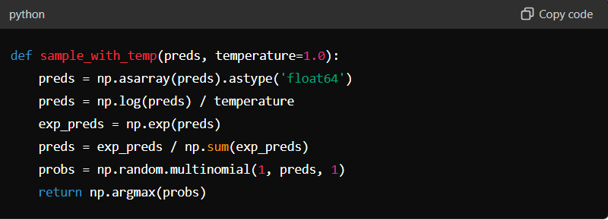
Example Code - Sampling Function

Slide 6
Text Generation Function
Text Generation Function
Content
Describe the generate_text function that uses the LSTM model to generate text
Explain the steps involved
Convert the seed text to a sequence of tokens
Predict the next word using the model
Append the predicted word to the seed text
Repeat the process to generate the desired number of words

Slide 7
Example Code - Text Generation
Example Code Text Generation
Content
Present the generate_text function in Python

Slide 8
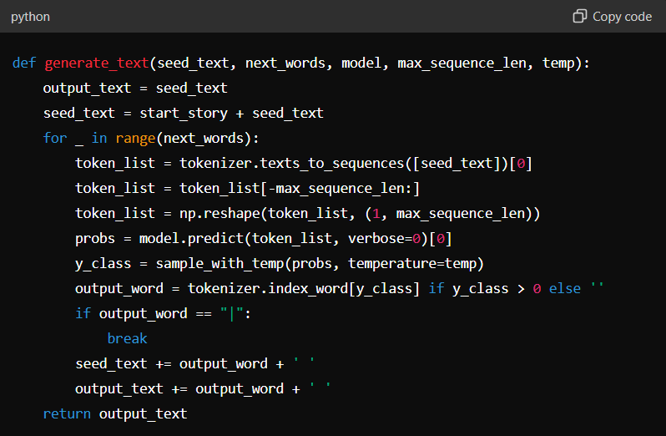

Slide 9
Temperature Impact
Impact of Temperature on Generation
Content
Discuss the effect of temperature on text generation
Low Temperature Generates text that is less adventurous but more coherent
High Temperature Generates text that is more diverse but less coherent
Provide examples to illustrate these differences

Slide 10
Examples of Generated Text
Examples of Generated Text
Content
Show passages generated at different temperatures
Highlight how lower temperatures produce safer, more predictable text, while higher temperatures produce more creative but sometimes nonsensical text

Slide 11
Human-Assisted Text Generation
Human-Assisted Text Generation
Content
Explain the concept of human-assisted text generation
The model suggests the top 10 words with the highest probabilities
A human selects the most appropriate word from the list
Compare this approach to predictive text on mobile devices

Slide 12

Probability Distributions
Word Probability Distributions
Content
Show examples of word probability distributions following various sequences
Discuss how the model learns context and grammatical correctness even without explicit rules

Slide 13

Conclusion
Conclusion
Content
Summarize the process of generating text using LSTM networks
Highlight the importance of temperature in controlling text generation
Mention potential applications and future directions for improving text generation models

